Slide 1
Flight Cancellation Classiffication

Slide 2
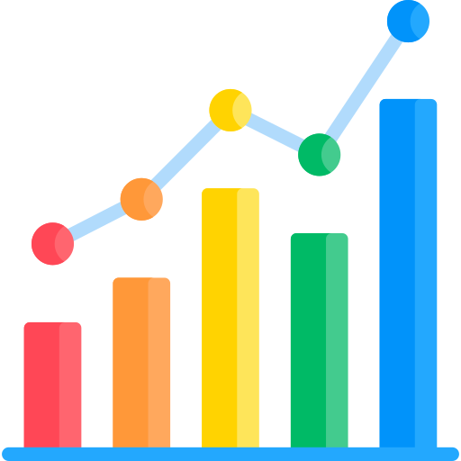
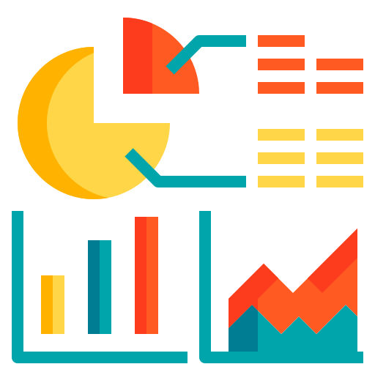

Agenda
01
02
03
04
Introduction
Result Analysis
Data Preprocessing
The End
Introduction about our dataset and dataset content
Answer the questions using the data
Data preprocessing and handle missing
The end of this presintation

Slide 3
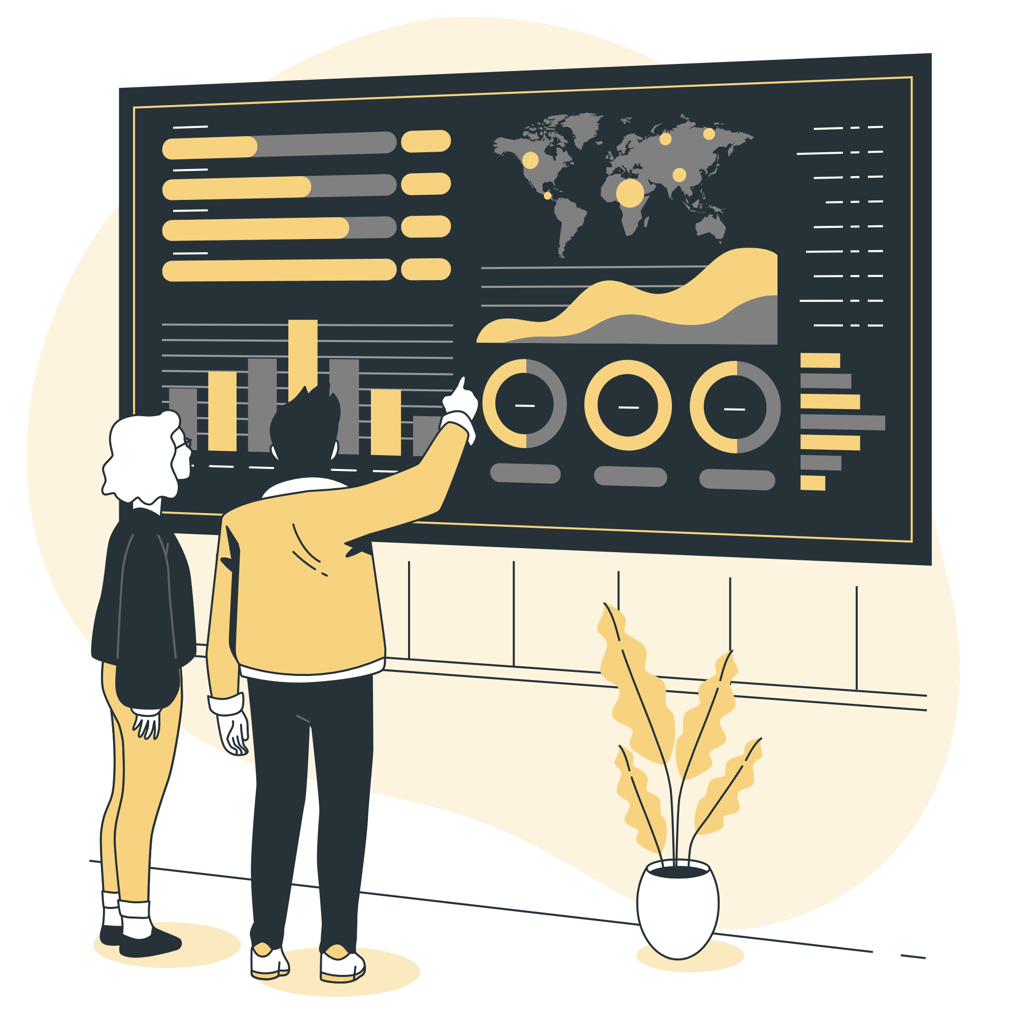
01. INTRODUCTION
Introduction about our dataset and dataset content

Slide 4
ABOUT DATASET
The U.S. Department of Transportation's (DOT) Bureau of Transportation Statistics tracks the on-time performance of domestic flights operated by large air carriers. Summary information on the number of on-time, delayed, canceled, and diverted flights is published in DOT's monthly Air Travel Consumer Report and in this dataset of 2015 flight delays and cancellations.

Slide 5
CONTENT
DATASET
(5.8m Row X 31 Feature)
Flight Trip Date
Flight Trip Information
Cancellation Status
4 Feature
7 Feature
20 Feature
( YEAR, MONTH, DAY, etc…)
(CANCELLATION, AIRLINE_DELAY, CANCELLATION_REASON, etc…)
( AIRLINE, FLIGHT_NUMBER,
DISTANCE, AIR_TIME, etc…)

Slide 6
#F89649
#FA7256
#F7D380
#F8B179

Slide 8
Travel Infographics
$2,000
$4,500
$3,000
Mercury is the closest planet to the Sun and the smallest
Venus is the second planet from the Sun. It’s terribly hot
Jupiter is the biggest planet in the entire Solar System

Slide 9
Travel Infographics
DAYS | Mercury is the closest planet to the Sun
COST | Venus has a beautiful name, but it's hot
CONFORT | It’s the biggest planet in the Solar System
DAYS | Despite being red, Mars is cold
COST | Saturn is the ringed one and a gas giant
CONFORT | Neptune is the farthest planet from the Sun

Slide 10
Travel Infographics
100%
Mercury is the closest planet to the Sun and the smallest one in the Solar System
90%
Despite being red, Mars is a cold place. It’s full of iron oxide dust
65%
Yes, this is the ringed one. It’s a gas giant, composed mostly of hydrogen and helium
25%
Saturn, the ringed planet, is composed mostly of hydrogen and helium

Slide 11
Travel Infographics
MERCURY
SATURN
Mercury is the closest planet to the Sun
Saturn is the ringed one and a gas giant
06
01
VENUS
JUPITER
05
02
Venus has a beautiful name and is hot
Jupiter is a gas giant and the biggest planet
MARS
04
03
NEPTUNE
Despite being red, Mars is actually a cold place
It’s the farthest planet from the Sun

Slide 12
Travel Infographics
MERCURY
SATURN
Mercury is the closest planet to the Sun
Saturn is the ringed one and a gas giant
06
01
VENUS
JUPITER
05
02
Venus has a beautiful name and is hot
Jupiter is a gas giant and the biggest planet
MARS
04
03
NEPTUNE
Despite being red, Mars is actually a cold place
It’s the farthest planet from the Sun

Slide 13
Travel Infographics
SWIMMING POOL
BEACH
RIVER
Despite being red, Mars is actually a cold place
Venus has a beautiful name and is the second planet
Mercury is the closest planet to the Sun and the smallest one
45%
2019
20%
2019
35%
2019

Slide 14
Travel Infographics
DESTINATION
Mercury is the closest planet to the Sun and the smallest one in the Solar System
PASSPORT
Despite being red, Mars is a cold place. It’s full of iron oxide dust
TICKET
It’s a gas giant and the biggest planet in our Solar System. It’s the fourth-brightest object in the sky

Slide 15
Travel Infographics
1 D
500$
22 D
100$
FLIGHTS
ROAD TRIPS
Mercury is the closest planet to the Sun and the smallest one in the Solar System
It’s a gas giant and the biggest planet in the Solar System. Jupiter is the fourth-brightest object
Venus has a beautiful name
Mercury is the
smallest planet
Mars is a cold place
Jupiter is a gas giant
Neptune is the
farthest planet
Saturn is the
ringed one

Slide 16
Travel Infographics
TRAVEL TO ITALY
1
2
3
4
5
6
7
Venus has a beautiful name and is hot
8
9
10
11
12
13
14
GREECE
Despite being red, Mars is a cold place
15
16
17
18
19
20
21
FREE TIME
22
23
24
25
26
27
28
Mercury is the closest planet to the Sun

Slide 17
Travel Infographics
ITALY
GREECE
FRANCE
Venus has a
beautiful name,
but it’s hot
Neptune is the
farthest planet
from the Sun
Saturn is the
ringed one and a gas giant
BRAZIL
SOUTH KOREA
CHINA
Despite being red, Mars is a cold place
Jupiter is a gas giant and the biggest planet
Mercury is the
closest planet to the Sun
100%
90%
80%
100%
80%
40%

Slide 18
Travel Infographics
PARIS
NEW YORK
KATHMANDU
AGRA
HANGZHOU
Venus has a beautiful name and is hot
Mercury is the
closest planet to the Sun
Despite being red, Mars is a cold place
Jupiter is a gas giant and the biggest planet
Neptune is the farthest planet from the Sun

Slide 19
Travel Infographics
 | SUITCASES | TICKET | PASSPORT
BUS
PLANE
TRAIN
SHIP

Slide 20
Travel Infographics
DINNER 1:00 PM
Jupiter is a gas giant and the biggest planet
MUSEUM 10:00 PM
Mercury is the closest planet to the Sun
TRAINS 8:30 PM
Despite being red, Mars is actually cold

Slide 21
Travel Infographics
45%
65%
Despite being red, Mars is actually cold
Mercury is the closest planet to the Sun
25%
85%
Jupiter is a gas giant and the biggest planet
Venus is the second planet from the Sun

Slide 22
Travel Infographics
AMERICAS
AUSTRALIA
Venus is the second planet from the Sun
It’s the biggest planet in the Solar System
35%
56%

Slide 23
Travel Infographics
WHAT
COUNTRY?
ITALY
GREECE
FRANCE
GERMANY
Mercury is the
closest planet to the Sun
Despite being red, Mars is a cold place
Jupiter is a gas giant and the biggest planet
Neptune is the farthest planet from the Sun

Slide 24
Travel Infographics
THRIFT
Mercury is the closest planet to the Sun
PLACES
Venus has a beautiful name, but also high temperatures
TOURISM
Jupiter is a gas giant and the biggest planet
TRAVEL
Despite being red, Mars is actually a cold place

Slide 25
Travel Infographics
ITALY
FRANCE
BELGIUM
Mercury is the closest planet to the Sun
Venus is the second planet from the Sun
Jupiter is a gas giant and the biggest planet
2016
2018
2019
2015
2017
2018
2020
CHINA
SOUTH KOREA
JAPAN
BRAZIL
Despite being red, Mars is a cold place
Earth is the planet where we live on
Neptune is the farthest planet from the Sun
Saturn is a gas giant and has several rings

Slide 26
Travel Infographics
50%
60%
85%
97%
SPRING
SUMMER
FALL
WINTER
Mercury is the closest planet to the Sun
Venus has a beautiful name and is hot
Despite being red, Mars is cold
Jupiter is a gas giant and the biggest planet

Slide 27
Travel Infographics
1
2
3
TRAVEL
CITY
PLACES
Mercury is the closest planet to the Sun and smallest one
Venus has a beautiful name and is the second planet
Despite being red, Mars is actually a really cold place

Slide 28
Travel Infographics
BEACH
MOUNTAIN
CITY
Mercury is the closest planet to the Sun
Venus has a beautiful name and is hot
Despite being red, Mars is actually cold
2
1
3

Slide 29
Travel Infographics
CITIE
1
3
RESTAURANTS
Mercury is the closest planet to the Sun
It’s a gas giant and the
biggest planet
MUSEUMS
2
4
MONUMENTS
Venus has a beautiful name and is hot
Despite being red, Mars is a really cold place

Slide 30
Travel Infographics
SUMMER
10%
30%
SPRING
Venus has a beautiful name and is the second planet
Neptune is the fourth-largest planet in the Solar System
25%
35%
WINTER
FALL
Mercury is the closest planet to the Sun and smallest one
Jupiter is the biggest planet in the entire Solar System

Slide 31
Travel Infographics
25%
45%
65%
TRAVEL BY SEA
TOURISM
GUIDE
It’s a gas giant and the biggest planet in the Solar System. Jupiter is the fourth-brightest
Mercury is the closest planet to the Sun and the smallest one in the Solar System
Venus has a beautiful name and is the second planet from the Sun. It’s terribly hot

Slide 32
Travel Infographics
65%
45%
CHINA
POLAND
Venus has a beautiful name and is the second planet
Despite being red, Mars is actually a really cold place
25%
32%
ANGOLA
TANZANIA
Mercury is the closest planet to the Sun and smallest one
Neptune is the fourth-largest planet in the Solar System

Slide 33
Travel Infographics
DATE
PLACE
REQUIREMENTS
Despite being red, Mars is actually a cold place
Venus has a beautiful name and is the second
Mercury is the closest planet to the Sun

Slide 34
Travel Infographics
CHINA
JAPAN
It’s the second-brightest natural object in the night
sky after the Moon
SEPTEMBER
Saturn is composed mostly of hydrogen and also helium
SUN
MON
TUE
WEN
THU
FRI
SAT
1
2
3
4
5
6
7
8
9
10
11
12
13
14
15
16
17
18
19
SOUTH KOREA
BRAZIL
Mercury is the closest planet to the Sun and the smallest one
20
21
22
23
24
25
26
Neptune is the fourth-largest planet in the Solar System
27
28
29
30
31

Slide 35
Travel Infographics
TRAVELLERS
PRICE
CONFORT
Mercury is the closest planet to the Sun and smallest one
45%
$25
60%
Despite being red, Mars is actually a cold place
30%
$40
60%
Saturn is composed mostly of hydrogen and helium
25%
$15
60%

Slide 36
Travel Infographics
UK
GREECE
AUSTRALIA
ITALY
Venus is the second planet from the Sun
Mercury is the closest planet to the Sun
Jupiter is a gas giant and the biggest one
Saturn is a gas giant and has several rings

Slide 37
Travel Infographics
Mercury is the smallest planet
BRAZIL
ITALY
Mercury is the smallest planet
Despite being red, Mars is cold
AUSTRIA
FRANCE
Despite being red, Mars is cold
It’s a gas giant and the biggest
VIETNAM
BELGIUM
It’s a gas giant and the biggest
Venus has a beautiful name
GERMANY
EGYPT
Venus has a beautiful name

Slide 38
Instructions for use (free users)
In order to use this template, you must credit Slidesgo by keeping the Thanks slide.
You are allowed to:
Modify this template.
Use it for both personal and commercial purposes.
You are not allowed to:
Sublicense, sell or rent any of Slidesgo Content (or a modified version of Slidesgo Content).
Distribute this Slidesgo Template (or a modified version of this Slidesgo Template) or include it in a database or in any other product or service that offers downloadable images, icons or presentations that may be subject to distribution or resale.
Use any of the elements that are part of this Slidesgo Template in an isolated and separated way from this Template.
Delete the “Thanks” or “Credits” slide.
Register any of the elements that are part of this template as a trademark or logo, or register it as a work in an intellectual property registry or similar.
For more information about editing slides, please read our FAQs or visit Slidesgo School:
https://slidesgo.com/faqs and https://slidesgo.com/slidesgo-school

Slide 39
Instructions for use (premium users)
In order to use this template, you must be a Premium user on Slidesgo.
You are allowed to:
Modify this template.
Use it for both personal and commercial purposes.
Hide or delete the “Thanks” slide and the mention to Slidesgo in the credits.
Share this template in an editable format with people who are not part of your team.
You are not allowed to:
Sublicense, sell or rent this Slidesgo Template (or a modified version of this Slidesgo Template).
Distribute this Slidesgo Template (or a modified version of this Slidesgo Template) or include it in a database or in any other product or service that offers downloadable images, icons or presentations that may be subject to distribution or resale.
Use any of the elements that are part of this Slidesgo Template in an isolated and separated way from this Template.
Register any of the elements that are part of this template as a trademark or logo, or register it as a work in an intellectual property registry or similar.
For more information about editing slides, please read our FAQs or visit Slidesgo School:
https://slidesgo.com/faqs and https://slidesgo.com/slidesgo-school

Slide 40
Infographics
You can add and edit some infographics to your presentation to present your data in a visual way.
Choose your favourite infographic and insert it in your presentation using Ctrl C + Ctrl V or Cmd C + Cmd V in Mac.
Select one of the parts and ungroup it by right-clicking and choosing “Ungroup”.
Change the color by clicking on the paint bucket.
Then resize the element by clicking and dragging one of the square-shaped points of its bounding box (the cursor should look like a double-headed arrow). Remember to hold Shift while dragging to keep the proportions.
Group the elements again by selecting them, right-clicking and choosing “Group”.
Repeat the steps above with the other parts and when you’re done editing, copy the end result and paste it into your presentation.
Remember to choose the “Keep source formatting” option so that it keeps the design. For more info, please visit Slidesgo School.

